Slide 1

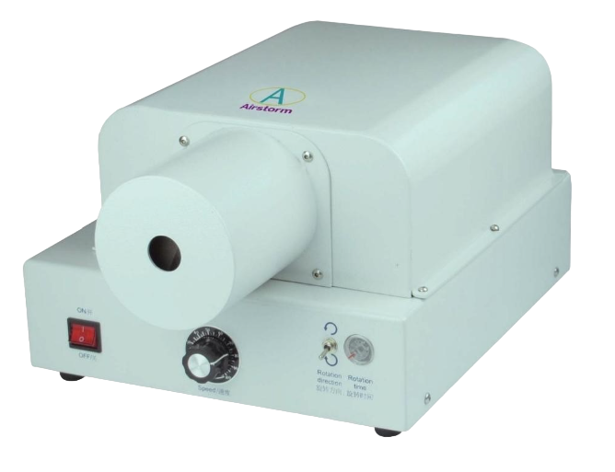
A-BT
Braid Twist Machine
  Can process different types of wires braids
  No need to adjustment set up when changing wires
  Mechanical structure is simple and convenient, highly flexible when using different cross sections
Technical Specifications
Jaw Open Distance | Minimum 0.5mm; Maximum 20mm
Twisting Speed | Adjustable
Twisting Direction | Adjustable
Twisting Time | Adjustable
Cycle Time | Approx. 3 sec. (Depend on wire braid and operator)
Twisting Length | From 5mm to 350mm can be adjusted accurately, over 350mm can be set approximately
Production Rate | More than 1000pcs/hour
Twist Clamp | 2 Two clamps
Trigger | Foot pedal
Air Supply | 0.5~0.7Mpa
Power Supply | AC220~240V,50~60Hz, Fuses 3.1 5A,300VA
Dimension (LxWxH) | 43 x 27 x 19 cm
Weight | 5.0 Kg

