Slide 1

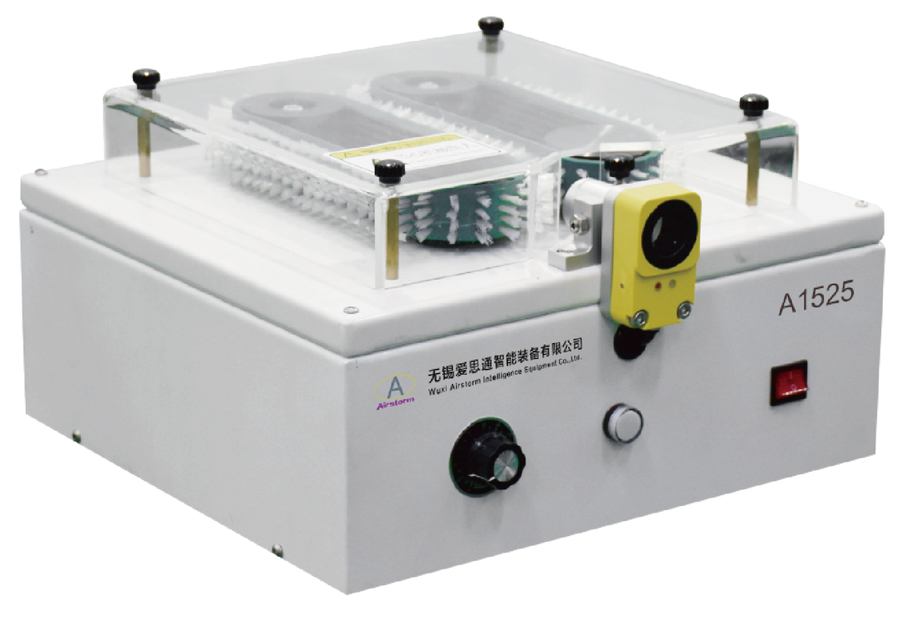
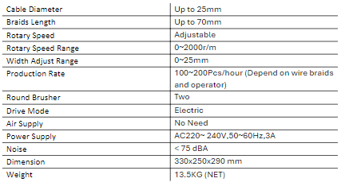
A1525
Braid Brushing Machine
  Simple, safe and easy operation
  Demerge braid from various cables diameters
  Only adjust the rotary speed and width when change wire
Technical Specifications

