Slide 1

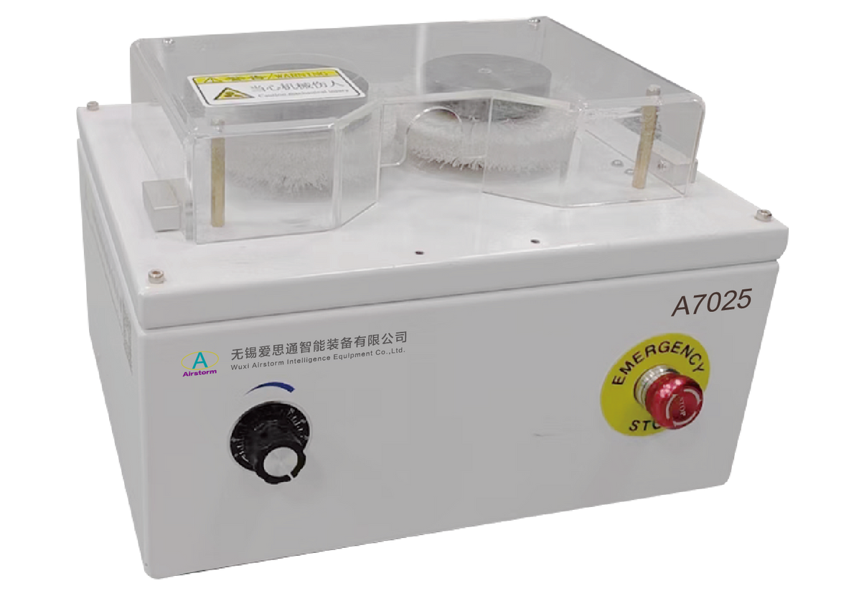
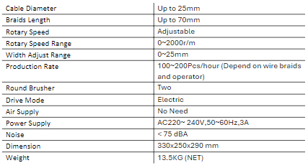
A7025
Braids Brushing Machine
  Simple, safe and easy operation
  Demerge braids for various cable diameters
  Only adjust the rotary speed and width when change wire
Technical Specifications

