Slide 1

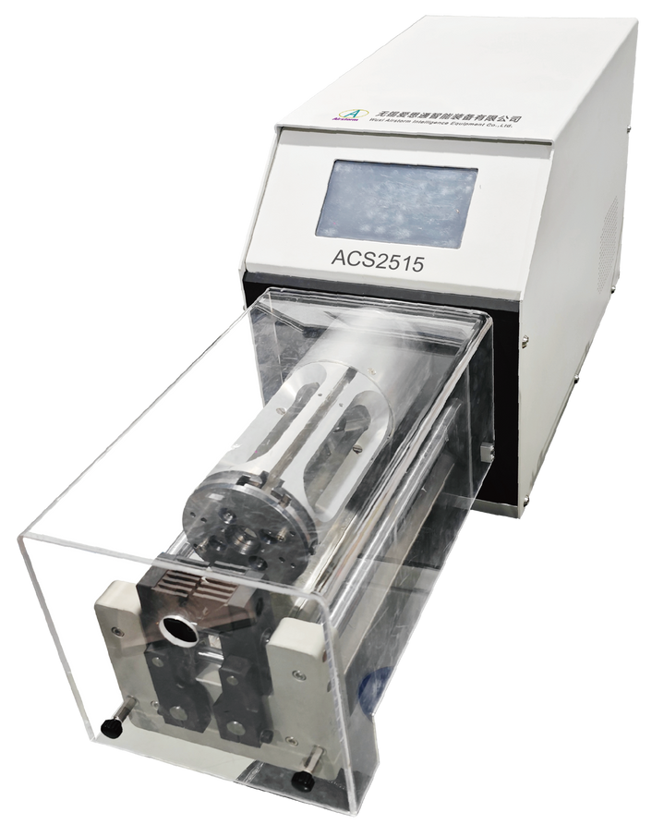
ACS2515
Semiautomatic Coaxial Cable Stripping Machine
  Fully programmable
  3D graphical interface
  Bar code scanning function
Technical Specifications
Max.Cable Diameter | 25mm
Diameter Increments | 0.01mm
Max. Stripping Length | 150mm
Stripping Length Increments | 0.01mm
Max. Stripping Steps | 9
Cycle Time | More than 4.5 seconds (Depend on cable type and program)
Production Rate | 550-600Pcs/hour (Depend on cable type and program)
Stripping Blades | 4
Program Capacity | 500 programs with 9 steps
Trigger | Foot pedal
Air Supply | 0.5~0.7Mpa
Power Supply | AC220~240V,50~60Hz, Fuses 5A 400VA
Noise | <75 dBA
Dimension (LxWxH) | 97 x 32 x 43 cm
Weight | 45 Kg

