Slide 1
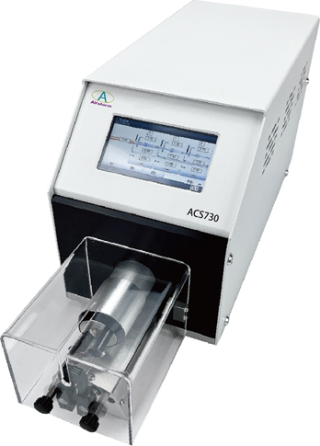

ACS730
Semiautomatic Coaxial Cable Stripping Machine
  Programmable for each step of each program
  Password protecting with different user
  Able to strip very thin and tough insulations due to the unique 2 blade concept
Technical Specifications
Max. Cable Diameter | 7 mm
Diameter Increments | 0.01mm
Max. Stripping Length | 30mm
Stripping Length Increments | 0.01mm
Max. Stripping Steps | 9
Cycle Time | More than 3 seconds (Depend on cable type and program)
Production Rate | 600-650Pcs/hour (Depend on cable type and program)
Stripping Blades | 2
Program Capacity | 500 programs with 9 steps
Trigger | Sensor/ Foot pedal (optional)
Power Supply | AC220~240V,50~60Hz, Fuses 5A 400VA
Noise | <75 dBA
Dimension (LxWxH) | 525x165x245 mm
Weight | 12 Kg

