Slide 1

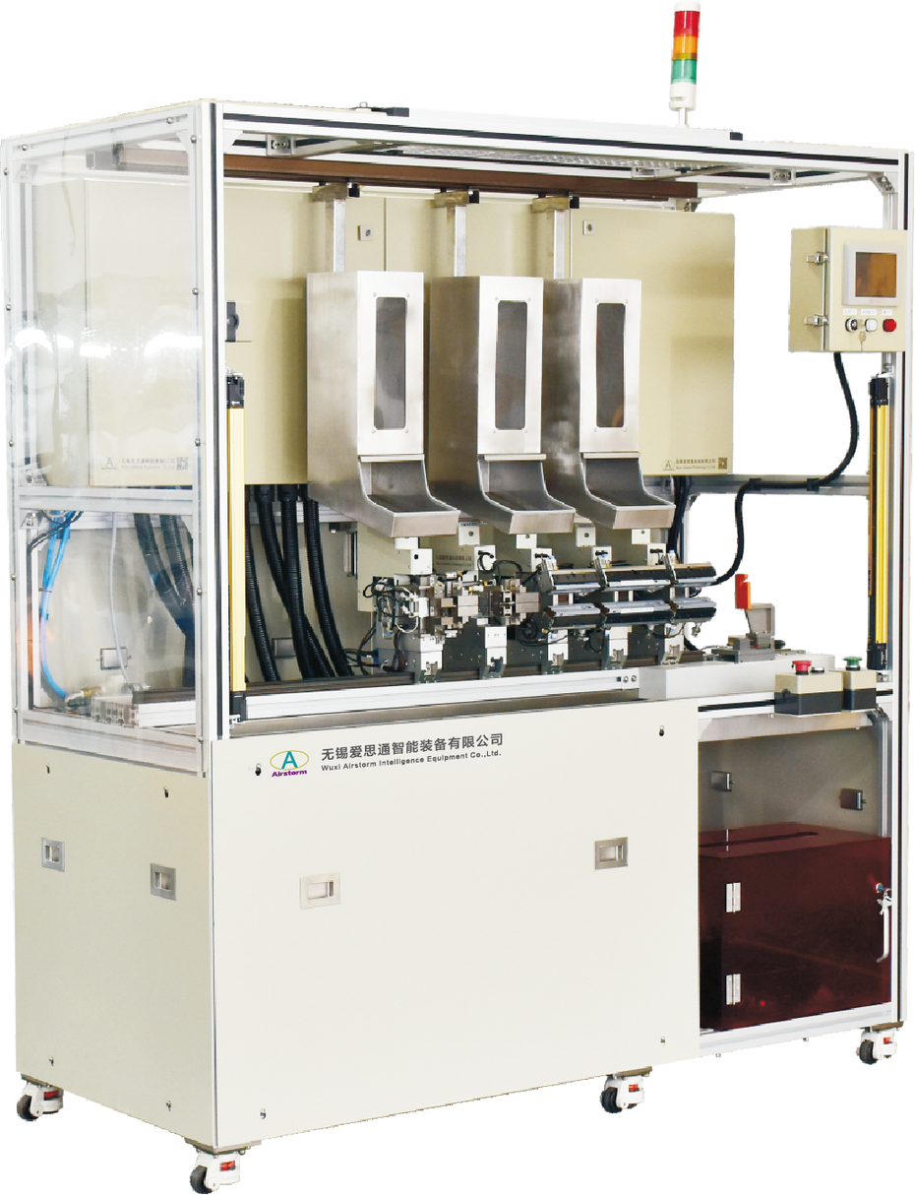
AGA300
Automatic Grommet Assembly Machine
  Detect module type automatically
  Programmable HMI for each module
  Error proofing system on grommet

Slide 2
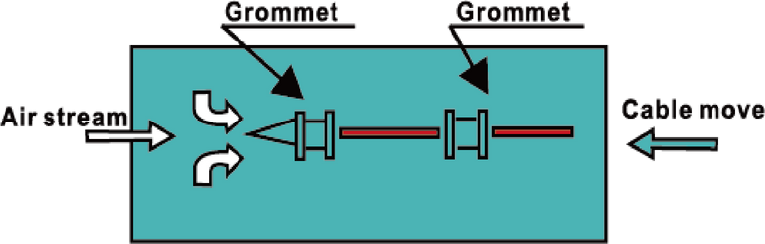
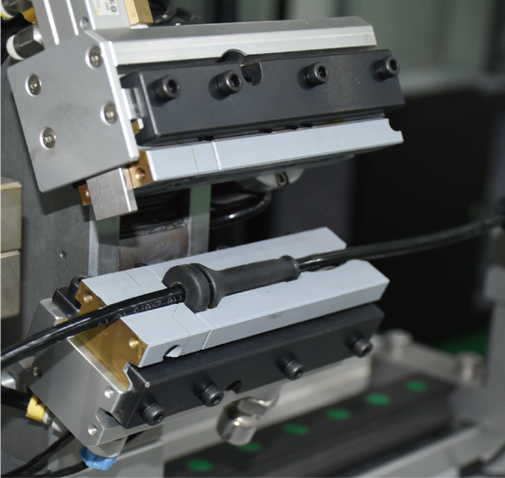
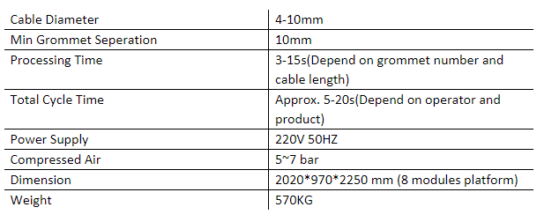
AGA300 is used for assembling the grommet on sensor cable of automotive wire harness, such as the Wheel Speed Sensor, ABS cable. The machine assembles the grommets automatically once the operator insert the cable into the first grommet modular. The concept and platform of machine ensure the position and angle of each grommet stable and repeatable.
Process
Module
Technical Specifications

