Slide 1

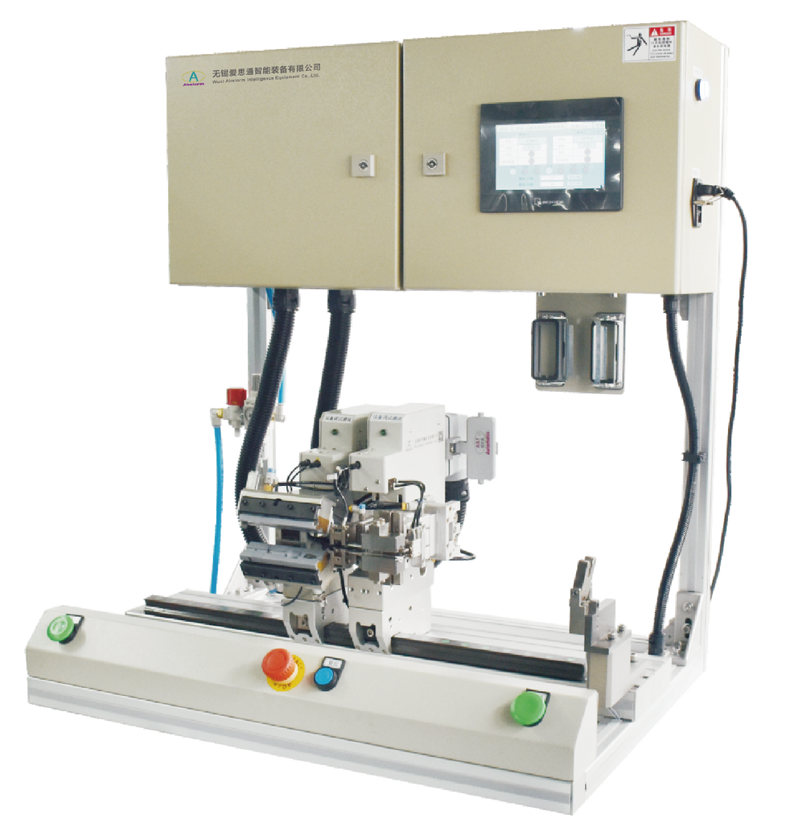
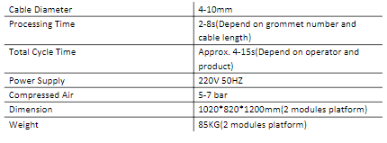
AGA310-2
Automatic Grommet Assembly Machine
  Detect module type automatically
  Programmable HMI for each module
  Error proofing system on grommet
Technical Specifications

