Slide 1

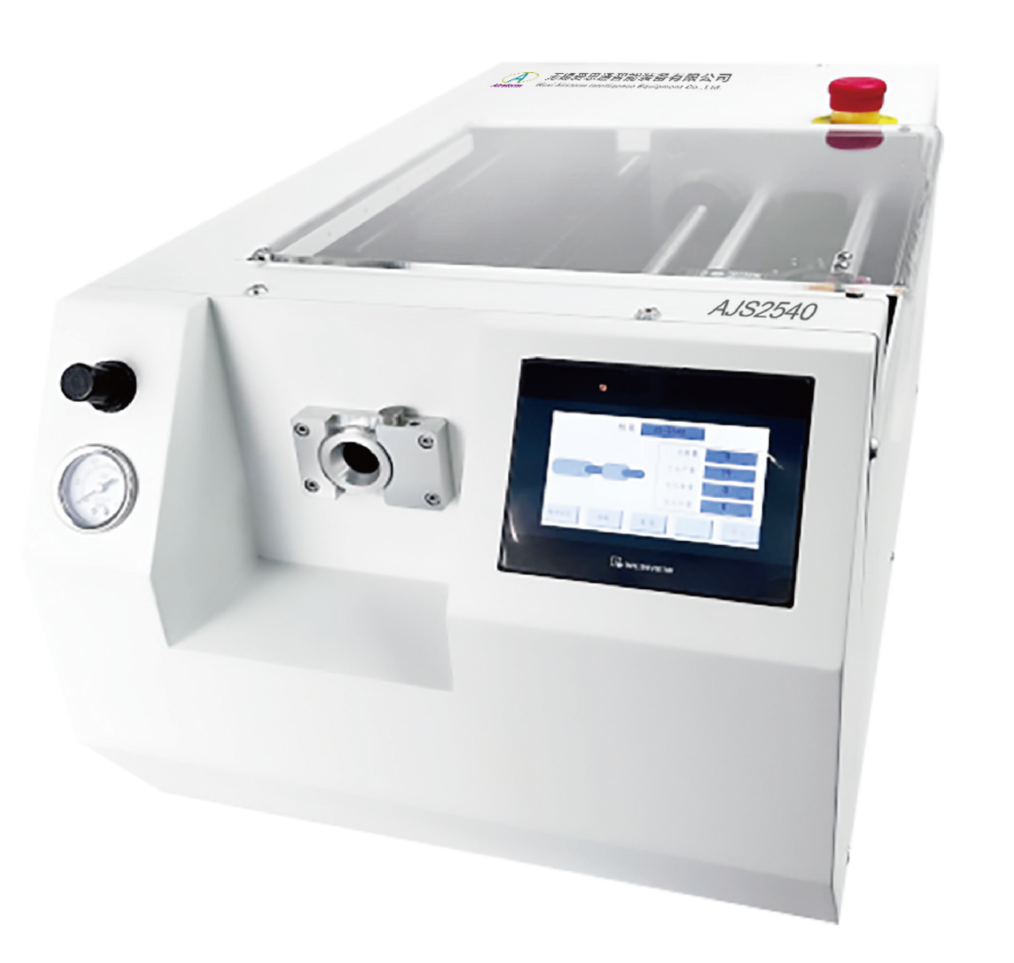
AJS2540
Jacket Stripping Machine
  One programming for two sides processing
  Rotary incision head with four-blade technology
  Handles thick cables and tough insulation materials
  Diagnostics features

Slide 2
The AJS2540 jacket stripping machine can strip the jackets of round wires and cables up to 26 mm in diameter with a stripping length up to 200mm. The solid, powerful machine processes thick, tough, soft and thin insulation materials. Simple operation, short cycle times and a universal blade design guarantee a good return on investment.
Technical Specifications
Display Interface | Touch Screen (Chinese/English)
Cable Diameter | Min. 2mm (0.08") Max. 26mm (1.0") (Outer ø)
Accuracy of Diameter | 0.1 mm - 0.25 mm (0.004-0.01") (Depend on ø)
Stripping Length | Adjustable from 7-200 mm (0.27"-7.87") Optional 200-400mm (7.87"-15.74")
Pull-off Length | Adjustable from 0-200mm (0"-7.87")
Accuracy of Length Adjustment | +/-0.01mm
Jacket Thickness | Up to a max. of 6mm (0.234")
Cycle Time | At least 2.0s (Depend on incision time and stripping)
Stripping Rate | Infinitely adjustable up to max. 35cm/s (1.4"/s)
Max.Stripping Steps | 9
Way back | +/-0.01mm
Blades | 4 universal blades (HSS)
Processable Insulation Materials | PVC, PUR, rubber, Teflon@, Tefzel@, Kapton, etc.
Program Capacity | 100 programs with 9 steps
Trigger | Foot pedal or Touch screen
Options | Cable guides, foot pedal
Air Pressure | 0.5-0.7 Mpa (5-7bar)
Power Supply | 230/240 VAC,50/60 Hz,800VA
Noise | < 70 dBA
Dimensions | 860x380x410mm
Weight | 65 Kg

