Slide 1

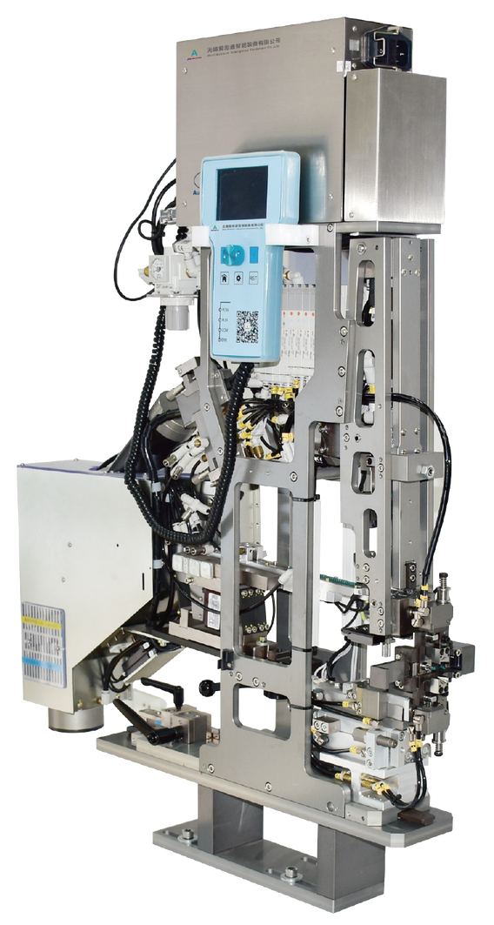
ASM400
Automatic Sealing Machine
  Suitable for different Cutting Machine
  Quick and reliable changeover without tooling help
  Cycle time 0.22S per Seal
Technical Specifications
Cable Diameter | 1-6mm
Seal Size | Diameter: < 17mm Height: ＜15mm
Processing Time | Approx. 0.22s
Total Cycle Time | Approx. 0.9 s (Depend on Air Pressure)
Power | 100-220VAC 50HZ 200W
Compressed Air | 5.5-7 Bar
Dimensions | L1098*W798*H352mm
Weight | 57 Kg

