Slide 1

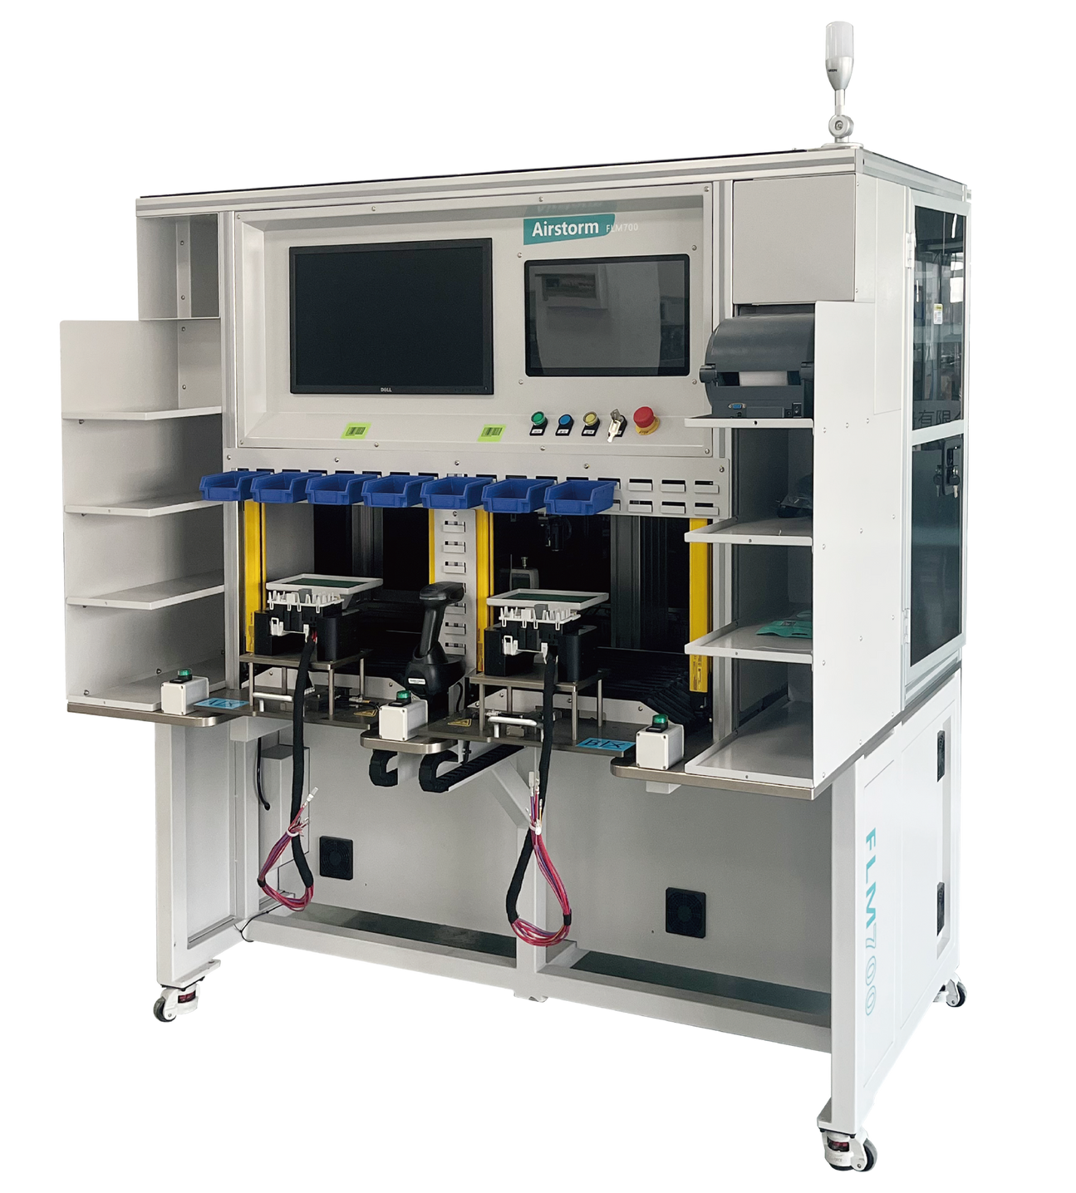
FMP700-N
Fuse Pressing Machine
  Remote data import and export
  Wide range of use, support for different
fuses and relays
  Two working stations
  High Speed camera to detect presence, color and shape from components

Slide 2
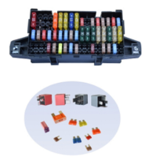
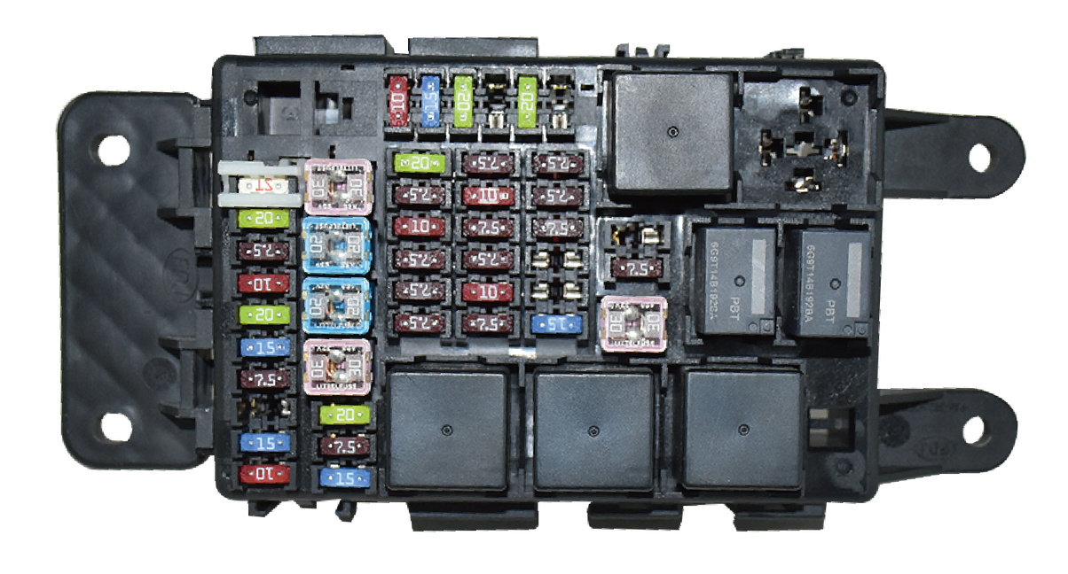
FPM700-N fuse pressing machine is a semi-automatic machine, mainly used in automotive wiring harness. Controls the fuse and relay pressure insertion and detection, in order to prevent leakage, false loading and other quality problems.
Samples
Technical Specifications
Available Connector Size | L250*W150*H150mm
Processing Time | 1-1.5 seconds/fuse
Total Cycle Time | Approx. 2min (Depending on operator and product complexity)
Power Supply | 220V 1500W 50Hz
Compressed Air | 5~7 Bar
Dimensions | L1600*W1150*H2100 mm
Weight | 600 Kg

