Slide 1

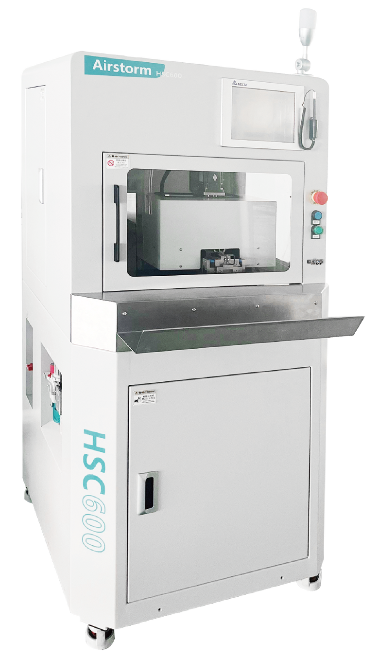
HSC600
Dual HV Cable Stripping Cutting Machine
  PC Touch HMI, PC-NET optional
  Parameter Saving & Loading
  Each function can be turned ON/OFF
Technical Specifications
Wire Outer Diameter | 4.5-7mm
Wire Cross Section | 2.5-6mm²
Jacket Stripping Length | 10-35 mm
Shield Braid Cutting Length | 0-28mm
Inner Insulation Stripping Length | 0-10mm
Cycle Time | Approx. 11 to 18s
Total Cycle Time | Approx. 15 to 22s
Dimension & Weight | 1400*1100*2010mm 350Kg
Power & Air | 220 VAC 4000W 5~7Bar

