Slide 1

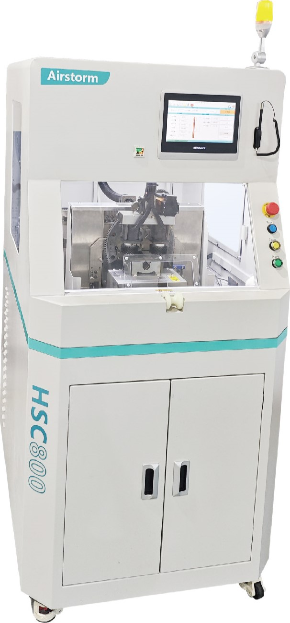
HSC800-5&7
HV Cable Stripping, Cutting and Folding Machine
  Easy to operate with a user-friendly HMI
  Each function, can be easily activate or deactivated
  Five manual processing steps, into only one step in a fully-automatic sequence
Technical Specifications
Cable Outer Diameter | 6 – 23 mm
Cable Cross Section | 6 – 120 mm²
Jacket Stripping Length | 5 – 100 mm
Foil Removal Length | 5 – 100 mm
Shield Braid Cutting Length | 10 – 95 mm
Inner Insulation Stripping Length | 5 – 95 mm
Cycle Time | 17 sec., depending on Product
Total Cycle Time | 20 sec., depending on Operator
Dimension & Weight | 820x1000x1600mm 280Kg
Power & Air | 380V 4000W 5 – 7 Bar

