Slide 1

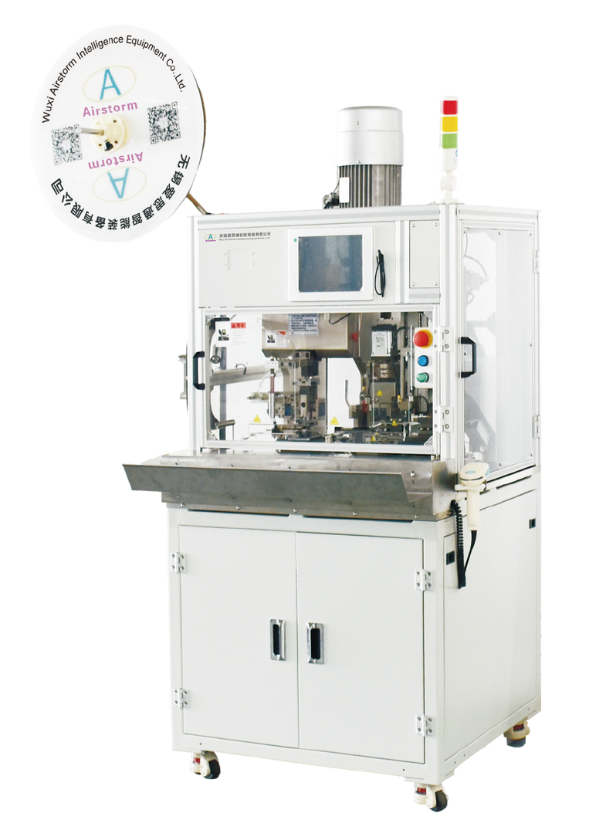
HSSC500-PCM
Heavy Duty Seal Stripper Crimping Machine
  Quick changeover production
  Waste Collection System
  Parameter Saving and Loading
Technical Specifications
Wire Size | 2-16mm²
Stripping Length | ≥14mm ≤40mm
Seal Dimension | OD ≤15mm Length ≤18mm
Press Crimp Force | 8 Tons
Press Stroke | 30 or 40mm
Machine Processing Time | Approx. 4.9s (Depend on products)
Total Cycle Time | Approx. 5.6s
Dimensions & Weight | L160*W130*H190mm 640Kg
Power & Air | 380VAC 50HZ 5-7Bar

