Slide 1

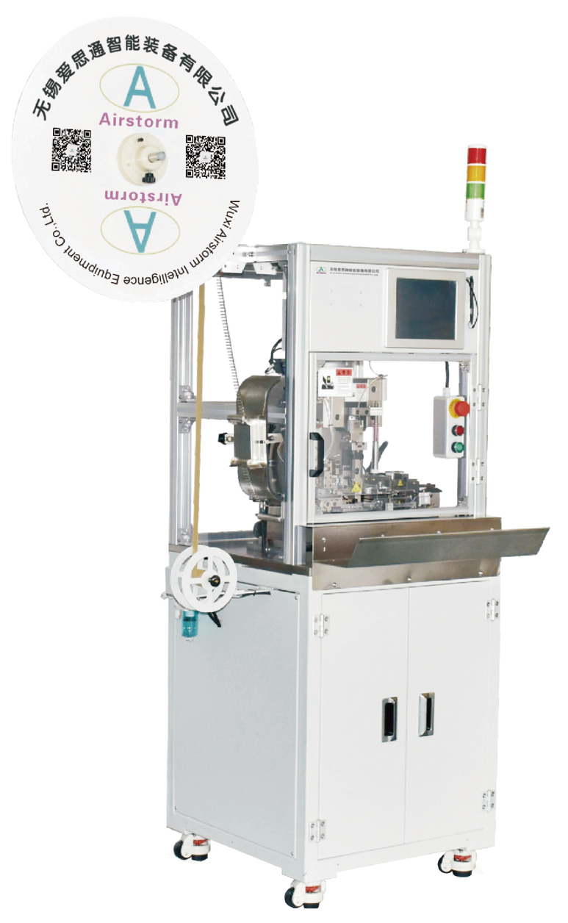
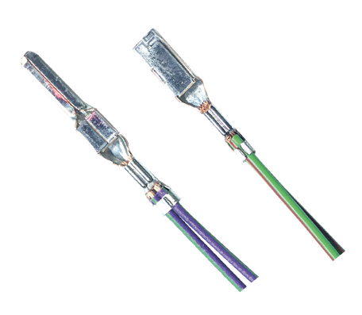
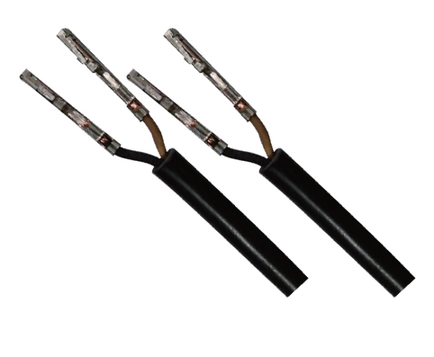
SC501-PCM
Dual Wire Strip Crimp Machine
  Quick changeover production
  Waste Collection System
  Stripping Check is an option

Slide 2
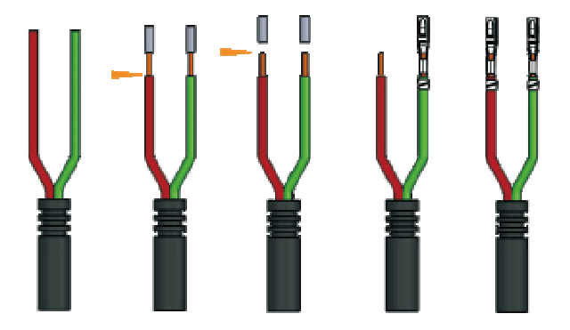
SC501-PCM is designed for processing the jacket cable and twisted cable, it integrates two functions, stripping and crimping of two wires in one cycle, a total cycle time of approximately 3.8 seconds, makes it the faster fully programmable double stripper crimper, in the market.
Process sequence
Technical Specifications
Wire Size | 0.13-2.5mm²
Jacket Stripping Length | ≥20 mm
Stripping Length | 1-8mm
Press Force | 2 Tons
Press Stroke | 30 or 40 mm
Machine Processing Time | Approx. 2.3s
Total Cycle Time | Approx. 3.8s (Depend on Operator)
Dimensions & Weight | L1080*W1120*H1890mm 383 Kg
Power & Air | 220 VAC 1500 W 5-7 Bar

