Slide 1

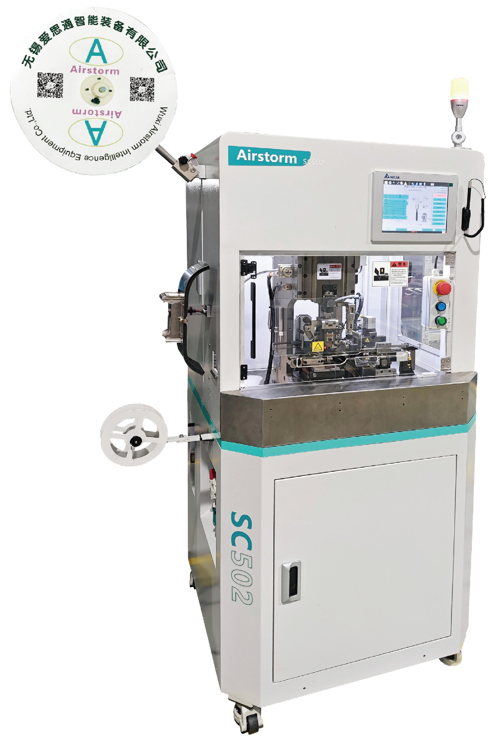
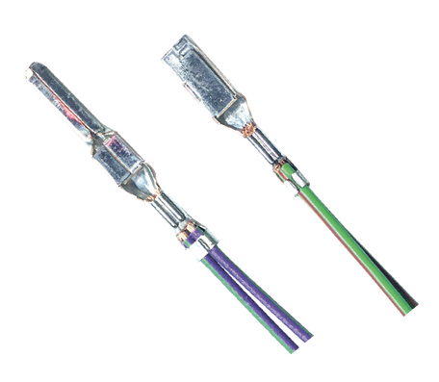
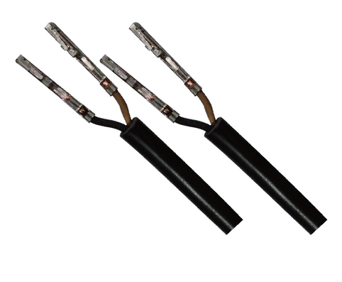
SC502
Dual Wire Strip Crimp Machine
  Quick changeover production
  Waste Collection System
  Stripping Check and CFM as standard delivery

Slide 2
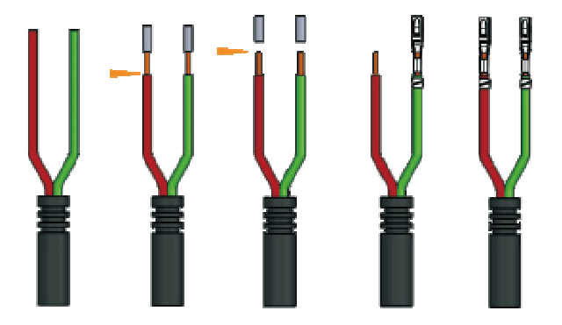
SC502 is designed for processing the jacket cable and twisted cable, it integrates two functions, stripping and crimping of two wires in one cycle, a total cycle time of approximately 3.6 seconds, makes it the faster fully programmable double stripper crimper, in the market.
Process sequence
Technical Specifications
Wire Size | 0.13-4.0mm²
Jacket Stripping Length | >19mm,High specification edition(compatible): 8.5-14mm
Stripping Length | 1-8mm
Press Force | 3 Tons
Press Stroke | 30 or 40 mm
Machine Processing Time | Approx. 2.0s
Total Cycle Time | Approx. 3.6s (Depend on Operator)
Dimensions & Weight | L980*W850*H1720mm 290 Kg
Power & Air | 220 VAC 1500 W 5-7 Bar

