Slide 1

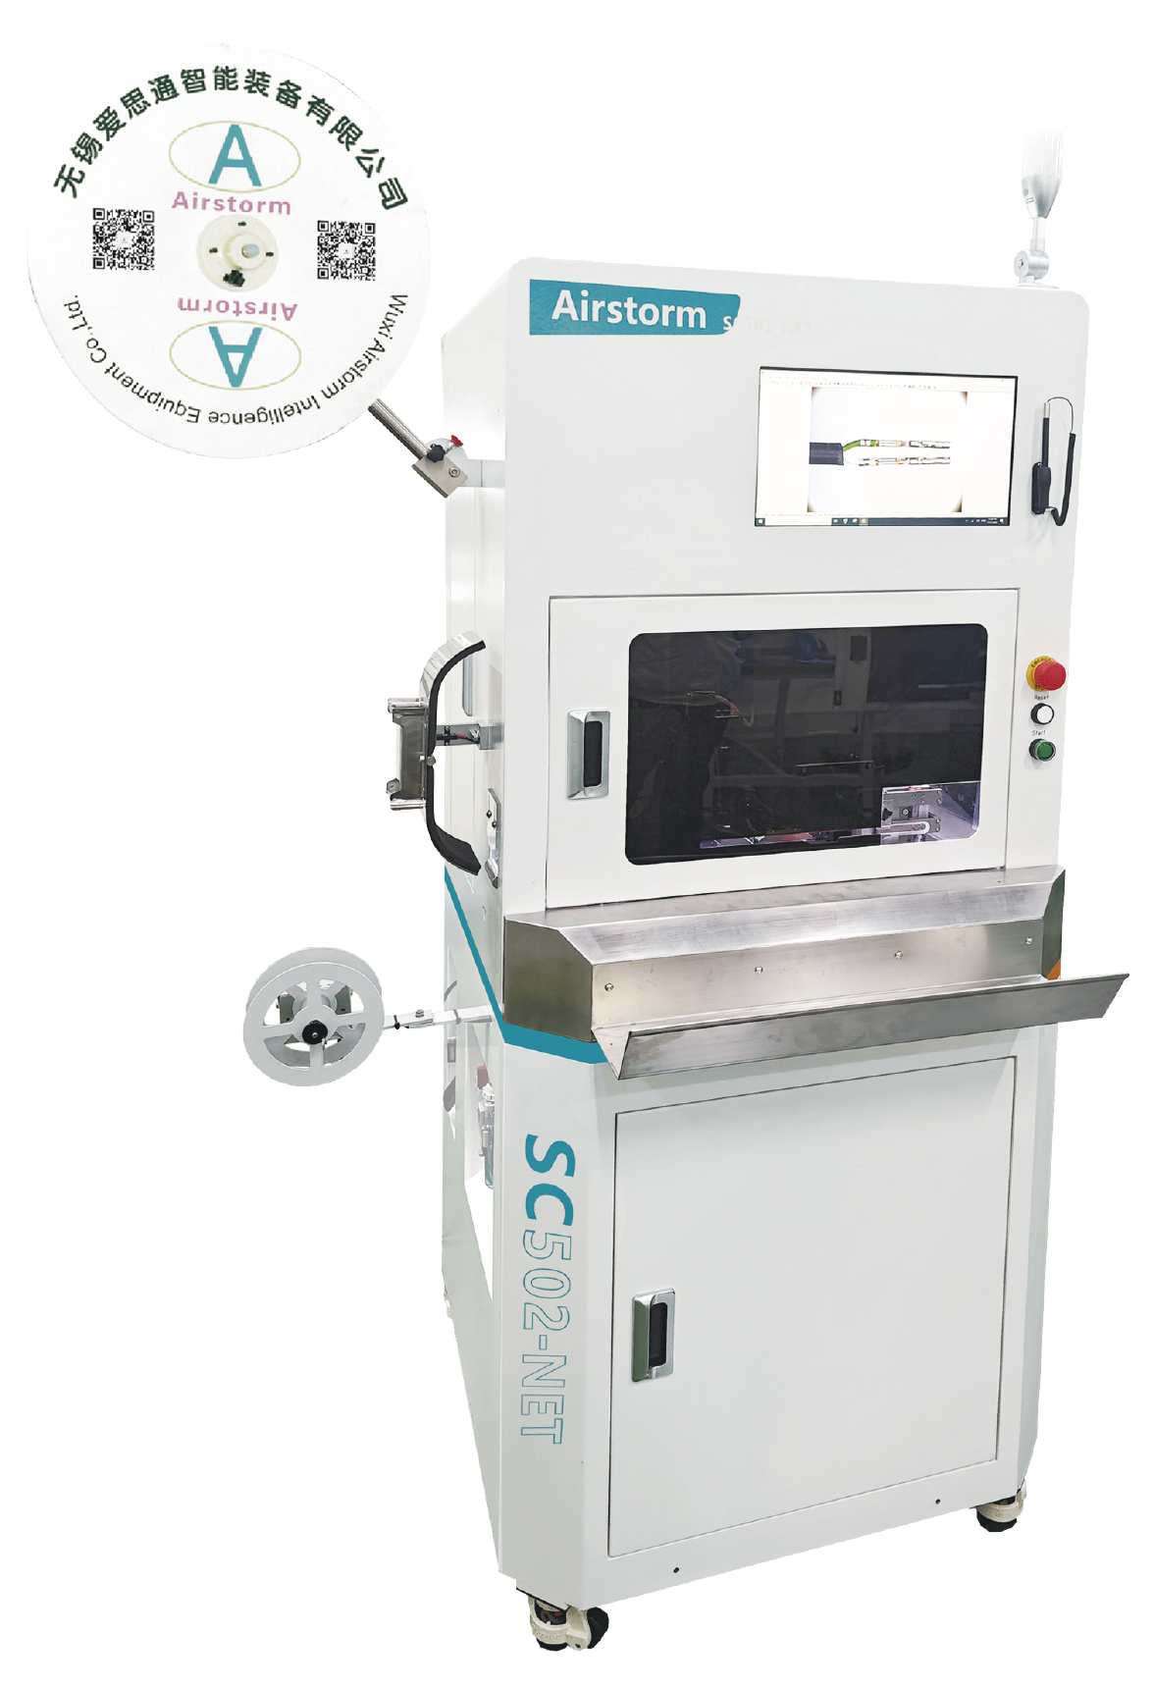
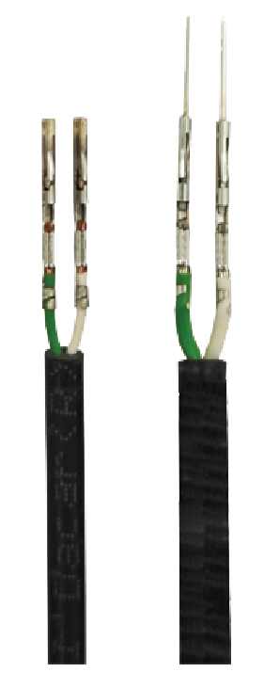
SC502-NET
Dual Wire Strip Crimp Machine for Ethernet cables
  Quick changeover production
  Waste Collection System
  Stripping Check included
  CFM included
  Ideal for Ethernet cable applications

Slide 2
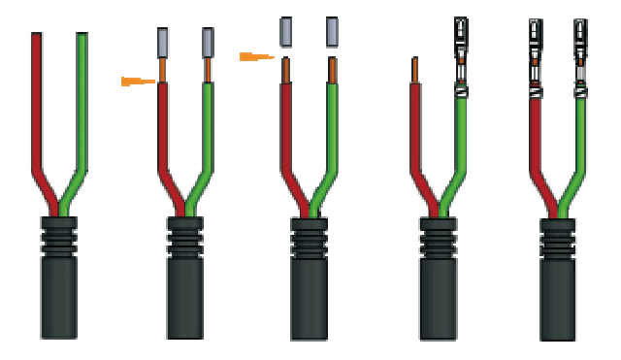
SC502-NET is designed for processing the jacket cable with twisted inner conductors, it integrates two functions, stripping and crimping of two wires in one cycle, a total cycle time of approximately 4.0 seconds, makes it the faster fully programmable double stripper crimper, in the market.
Process sequence
Technical Specifications
Wire Size | 0.13-0.5mm²
Jacket Stripping Length | 8-16mm (Depend on the length of the terminal)
Stripping Length | 1-8mm
Press Force | 3 Tons
Press Stroke | 30 or 40 mm
Machine Processing Time | Approx.4.0s(Without CCD); Approx.5.0s(With CCD)
Total Cycle Time | Approx.5.0s(Without CCD); Approx.6.0s(With CCD)
Dimensions & Weight | L750*W650*H1750mm 300 Kg
Power & Air | 220 VAC 1500 W 5-7 Bar

