Slide 1

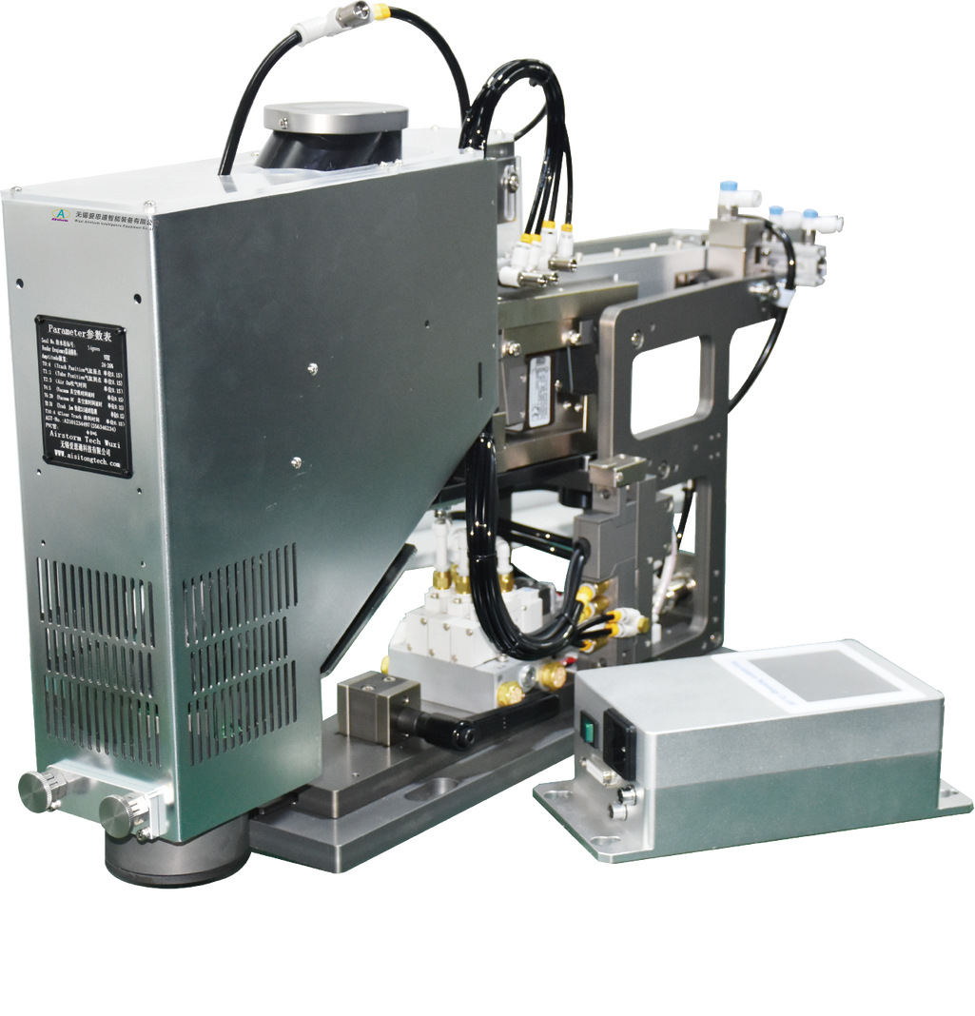
SKF-420
Seal Feeding Kit
  Convenient disassembly and maintenance
  Elliptic seal is possible
  Pulse vibration of direct current and high frequency for steady feeding
  Fast speed of 0.6seconds/Seal
Technical Specifications
Seal Type | Circular and Elliptic seal
Processing Time | Approx. 0.6 s
Power | 100- 220VAC 50HZ 200W
Compressed Air | 5.5-7Bar
Dimensions | L630*W415*H195mm
Weight | 20 Kg

