Slide 1

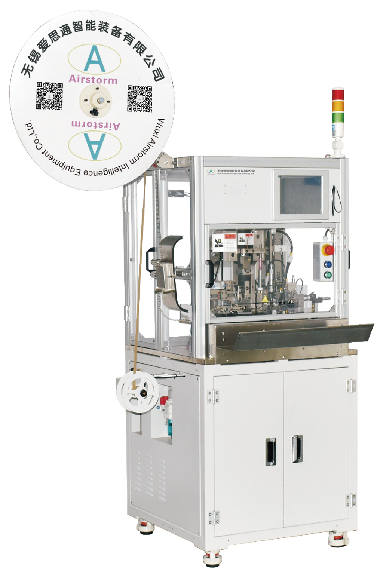
SSC501-PCM
Dual Wire Strip Seal Crimp Machine
  Sensor actuator
  Each function can be turned ON/OFF
  Quick changeover production
  Color detection option
  Strip quality check as standard

Slide 2
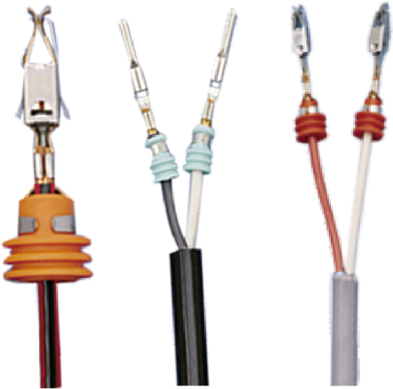
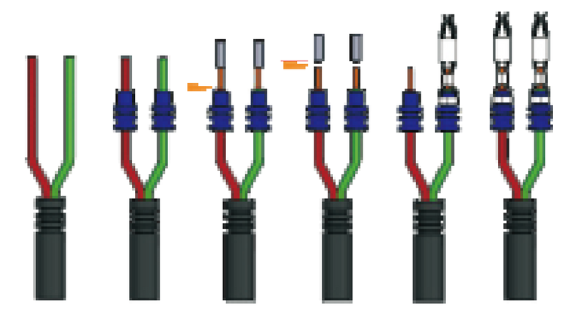
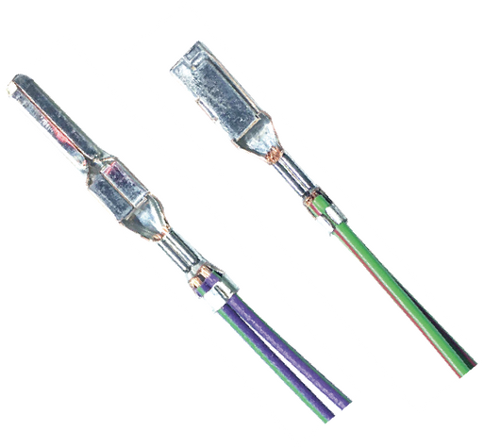
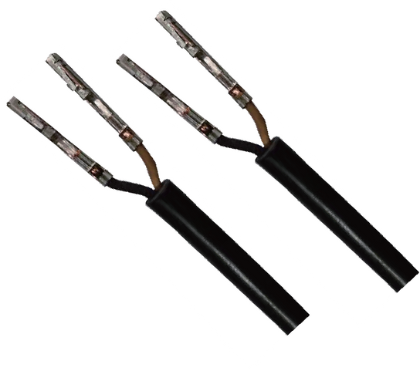
SSC501 is designed for processing the jacket cable and twisted cable. It is a semiautomatic machine that integrates three functions: sealing-stripping-crimping of two wires in one cycle, in a cycle time of approximately 4.3 seconds. The SSC501 is the perfect entry level machine in it's segment with high cost/benefit.
Technical Specifications
Wire Size | 0.13-4mm²
Jacket Stripping Length | >25mm (With Seal) ≥22mm (Without Seal)
Stripping Length | 1-8 mm
Seal Dimension | 2-8mm OD
Press Force | 3 Tons
Press Stroke | 30 or 40mm
Machine Processing Time | Approx. 3.1 s
Total Cycle Time | Approx. 4.3 s (Depending on operator)
Dimension & Weight | L1080*W1120*H1890mm 440Kg
Power & Air | 220VAC 1500W 5-7Bar

