Slide 1

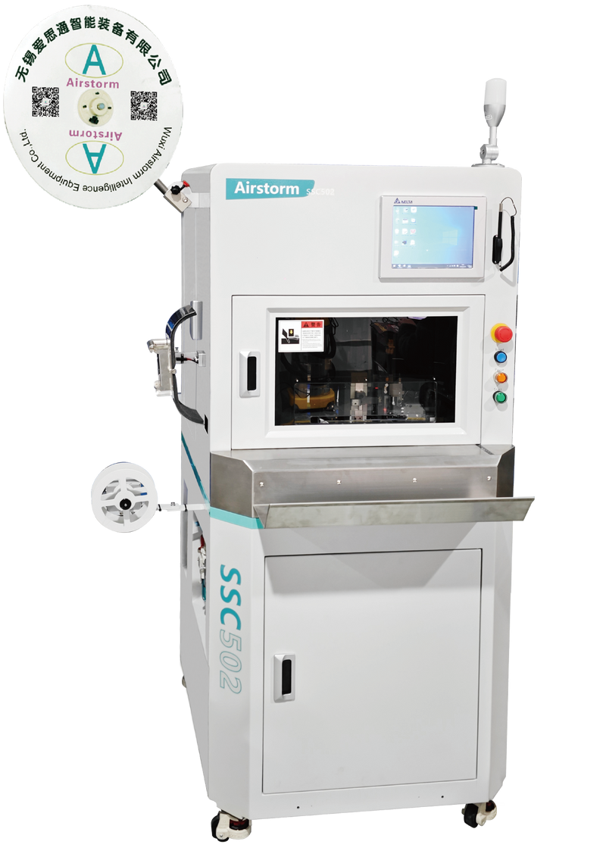
SSC502
Dual Wire Strip Seal Crimp Machine
  Quick production changeover
  Waste Collection System
  Servo press with automatic adjustment of crimping height (option）
  Strip quality check as standard
  CFM included as standard

Slide 2
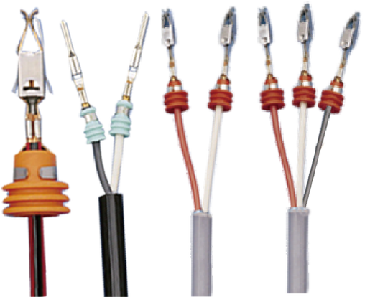
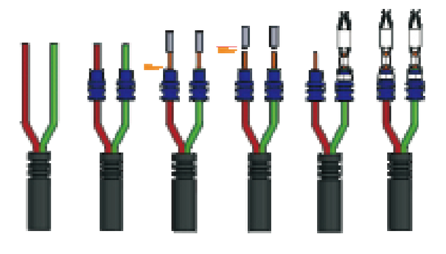
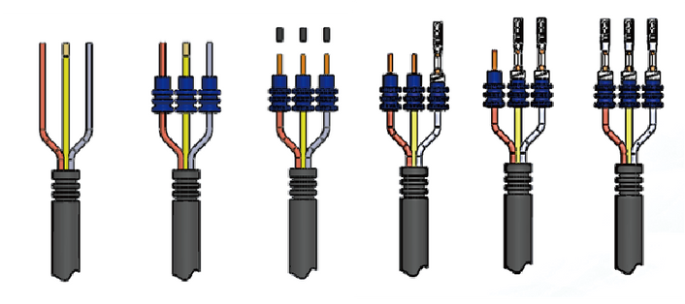
Sample Example
Process Sequence
Technical Specifications
Wire Size | 0.13-4mm²
Jacket Stripping Length | >25mm (With Seal) ≥22mm (Without Seal)
Stripping Length | 1-8 mm
Seal Dimension | 2-8mm OD
Press Force | 3 Tons
Press Stroke | 30 or 40mm
Machine Processing Time | Approx. 3.1 s
Total Cycle Time | Approx. 4.3 s (Depending on operator)
Dimension & Weight | L1080*W1120*H1890mm 440Kg
Power & Air | 220VAC 1500W 5-7Bar

