Slide 1

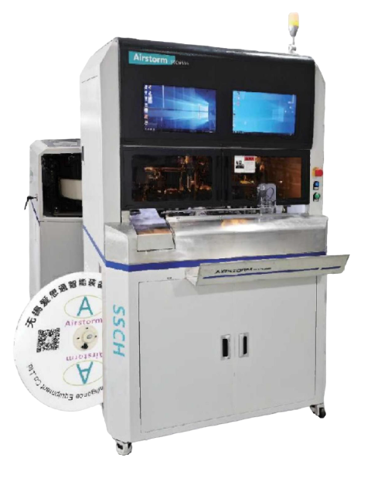
SSCH502
Strip Seal Crimp Housing Insertion Machine
  Terminal crimping CCD detection (Option)
  Parameter saving and loading
  Semi-automatic machine, easy to operate.
  CFM, strip check monitoring as standard
Technical Specifications
Wire section | 0.13-4mm²
Minimum Jacket Stripping Length | 30 mm
Seal Dimension | 1-7 mm
Press Crimp Force | 3 Tons
Press Stroke | 30 or 40mm
Machine Processing Time | Approx. 10 s (Depending on products)
Total Cycle Time | Approx. 10 s (Depending on productsand operator)
Dimensions & Weight | L1080*W1120*H1890 mm 440Kg
Power & Air | 220VAC 1500W 5-7Bar

