Slide 1

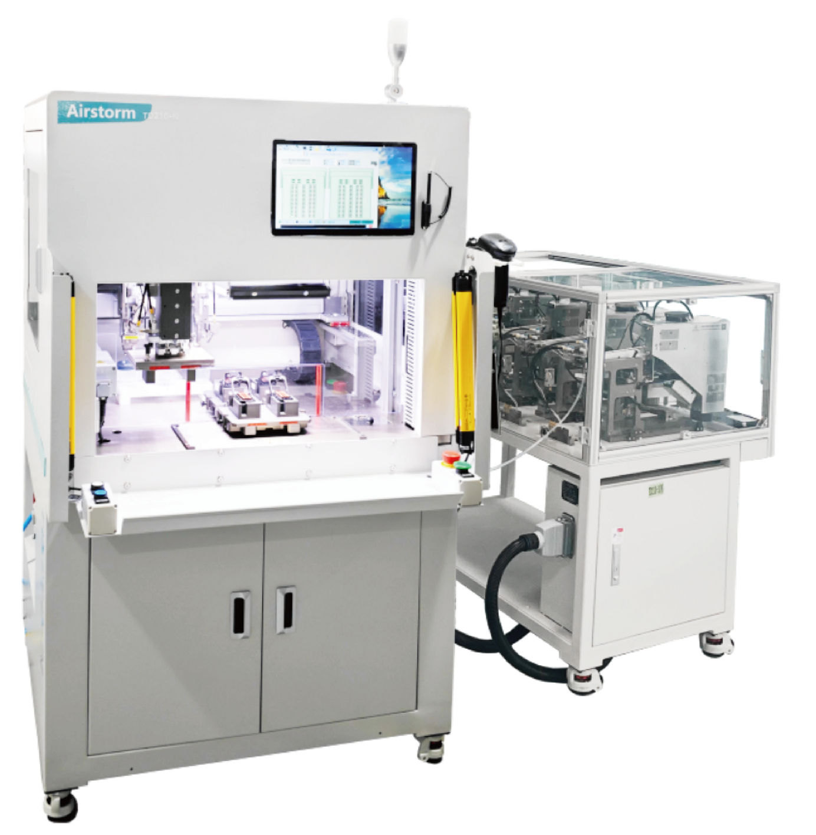
TD210-NP
Blind Seal Machine
  Modular concept design
  Quick Tooling changeover
  Can insert blind seals and sticks
  Camera detection as optional

Slide 2
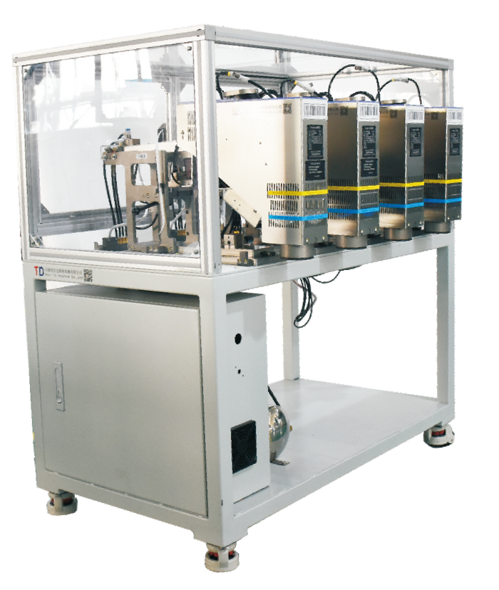
The TD210-NP blind seal loading machine is a semi-automatic machine which is able to insert blind seals/sticks in automotive connectors. The TD210-NP is configured with a maximum of 3 sets of insertion nozzle, supporting the production of 3 different seals/sticks in the same connector, making the changeover more flexible. An efficiency of 0.5sec/seal can be achieved by using the double insertion model. With the emerging of new processes, we have added a reverse function on top of the TD210-NP equipment: punching function…
FTC4 CHART
Seal kit rack/feeding system
Technical Specifications
Biggest Connector size | L80*W50mm
Plug Type | no direction on Y axis
Blinding Seal Time | <1 second/hole
Changeover Time | 1 min
Power | 220V 50Hz 400W
Compressed Air | 5-8 Bar
Dimensions L*W*H | 1080*1220*1800mm (TD-210.N) 740*810*1300mm (FTC-4 Chart)
Weight | 430 Kg (TD210-N) 220 Kg (FTC-4)

